Slide 1
Integrate Pub/Sub with ITS
Overview and Examples

Slide 2
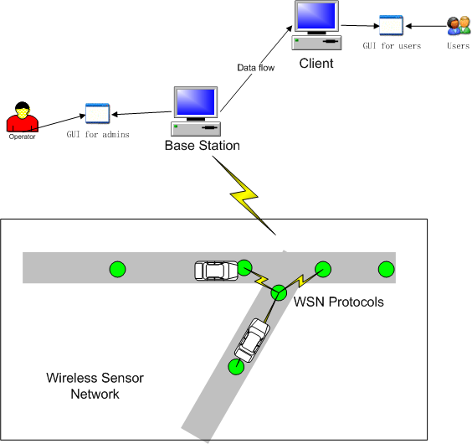
ITS Overview

Slide 3

Collision Detection Protocol
Assumptions:
  Single-lane roads.
  Each sensor knows its own and its neighbor’s location.
Illustration

Slide 4

Logic Positioning Protocol
Assumption:
  Transmission ranges of all the sensors are approximately the same.
  Sensors are uniformly distributed on the road.
Coordinate system:

Slide 5
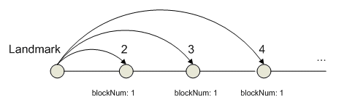
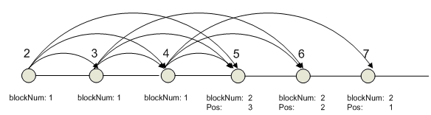
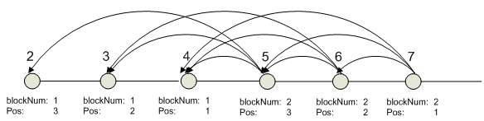
Logic Positioning Protocol

Slide 6
Pub/Sub Implementation of Collision Detection Protocol
Subscribers: vehicles
Events:
  Vehicle Detection: VehicleEvent (vehicleID, location).
  Vehicle Speed Detection: VehicleSpeed (vehicleID, location, speed).
  Collision Warning: CollisionEvent
Event Composition:
  Vehicle Detection => Vehicle Speed Detection => Collision Warning

Slide 7
VehicleEvent
9: public boolean occurred () {
10: if (light<threshold)
11: return true;
12: else
13: return false;
14: }

Slide 8
VehicleSpeed
10: vehicleID=ve.vehicleID;
11: location=ve.location;
12: walkthrough {
13: VehicleEvent ve2=new VehicleEvent();
14: if(ve2.vehicleID==vehicleID && ve2.location==location-1) {
15: speed=ve2.location-location;
16: return true;
17: }
18: }

Slide 9
CollisionEvent
5: if (vs.occurrred() && vs.vehicleID==currentVehicleID) {
6: walkthrough {
7: VehicleSpeed vs2 = new VehicleSpeed();
8: if (vs2.occurred() && vs2.vehicleID!=currentVehicleID) {
9: /* Collision detection policies.
10: May return true or false. */
11: }
12: }
13:}

Slide 10
Pub/Sub Implementation of Logic Positioning Protocol
Subscriber: sink (to kick-start the protocol)
Coordinates are stored in static attributes in an Event.
Component that provides system-wide utilities is used.

Slide 11
Pub/Sub Implementation of Logic Positioning Protocol
1: Event MessageEvent {
2: static int block=0;
3: static int pos=0;
4: boolean isLandmark;
5: int receivedMsg;
6: public MessageEvent () {
7: if (isLandmark)
8: System.send(0, 0xff);
9: }
10: public boolean occurred() {
11: block=receivedMsg+1;
12: pos++;
13: }
14: }

